Slide 1

Data Engineering & Analytical Solution
Ahmed monged

Slide 2



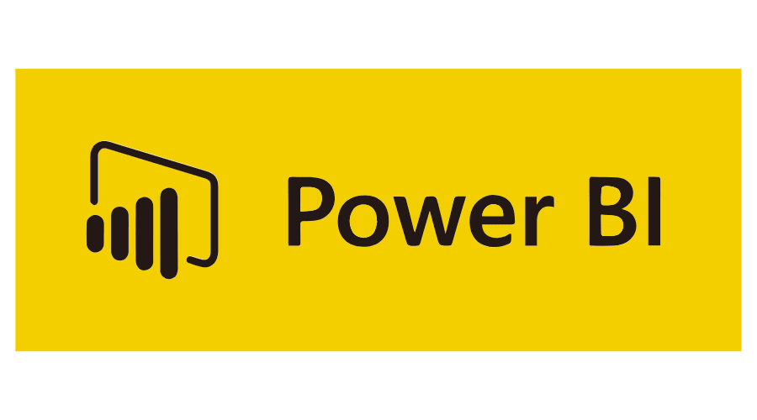
introduction

Slide 3

AZURE DATA FACTORY

Slide 4

About azure data factory
Azure Data Factory (ADF) is a cloud-based data integration service provided by Microsoft Azure. It allows you to create, schedule, and manage data pipelines for moving and transforming data from various sources to different destinations.

Slide 5
Steps taken
Create Linked Services
Create Datasets
Create Activities
Copy Activity
Email Activity
Create Pipeline
Add Dependency
Monitoring and Error Handling
Test Pipeline
Create Linked Services
Create Datasets
Create Activities
Copy Activity
Email Activity
Create Pipeline
Add Dependency
Monitoring and Error Handling
Test Pipeline

Slide 6
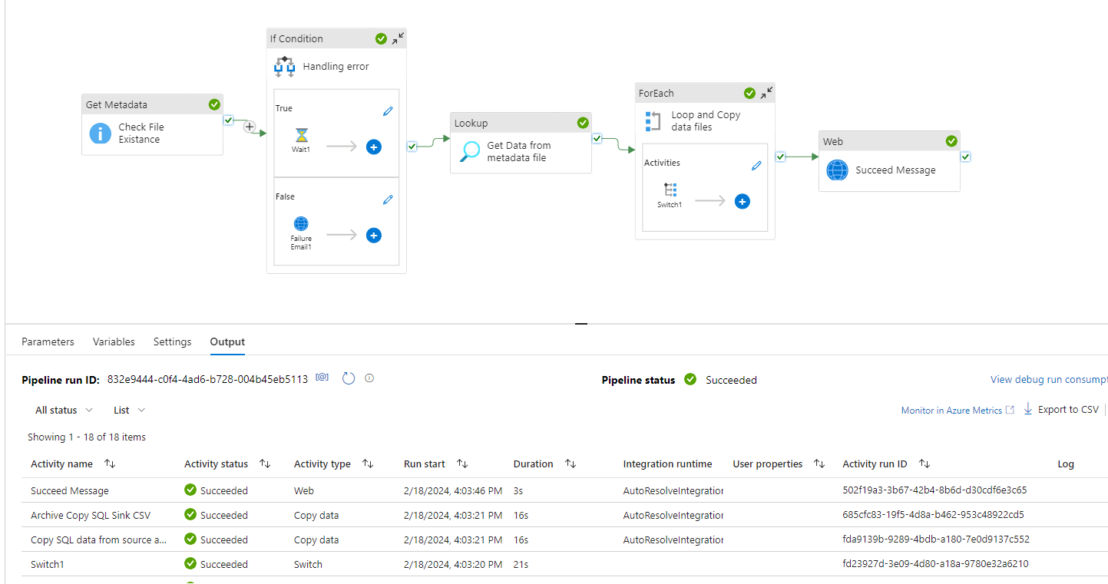
Pipeline creation

Slide 7
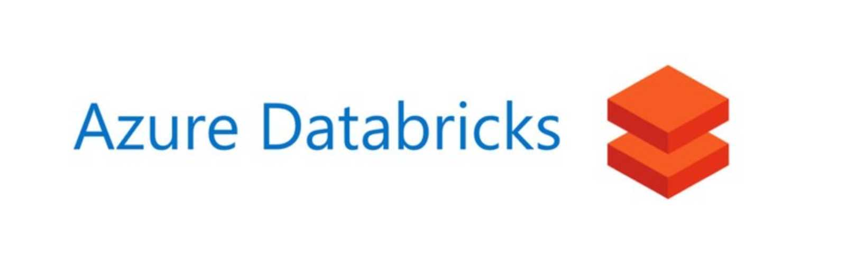
AZURE DATAbricks

Slide 8

About azure databricks
Azure Databricks is a cloud-based unified analytics platform provided by Microsoft Azure, built in collaboration with Databricks.

Slide 9
steps
Setup Databricks Workspace
Create a Notebook
Load Data
Data Manipulation and Cleaning
Data Analysis and Transformation
Create Output Table
Write Data to Output Table

Slide 10
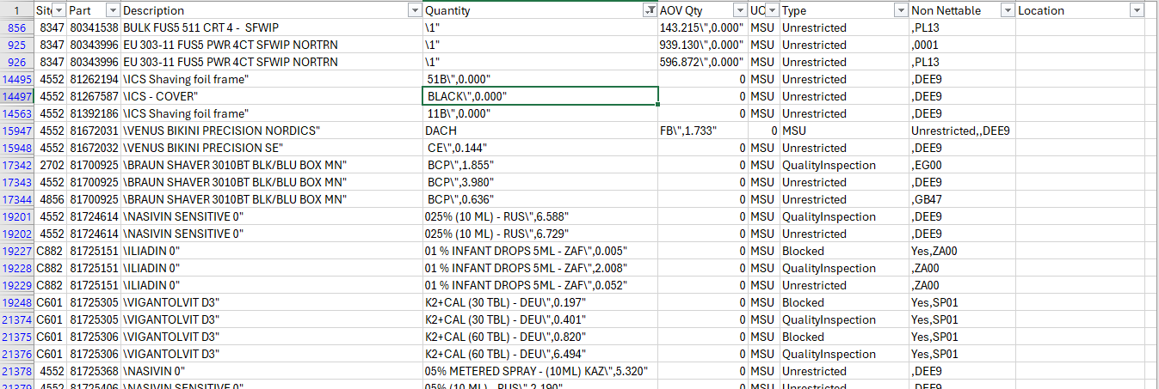
DATA MANIPULATION Csv wrong format

Slide 11
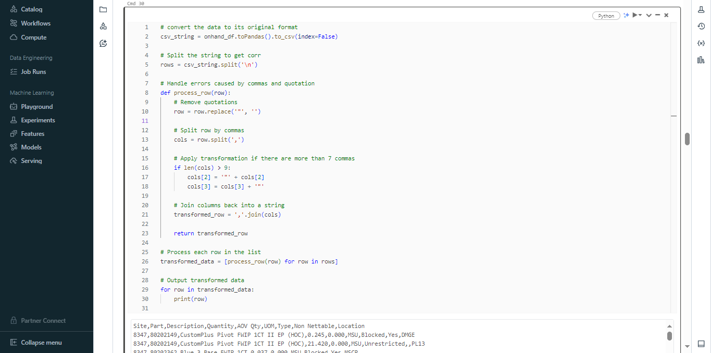
DATA MANIPULATION CSV WRONG FORMAT

Slide 12
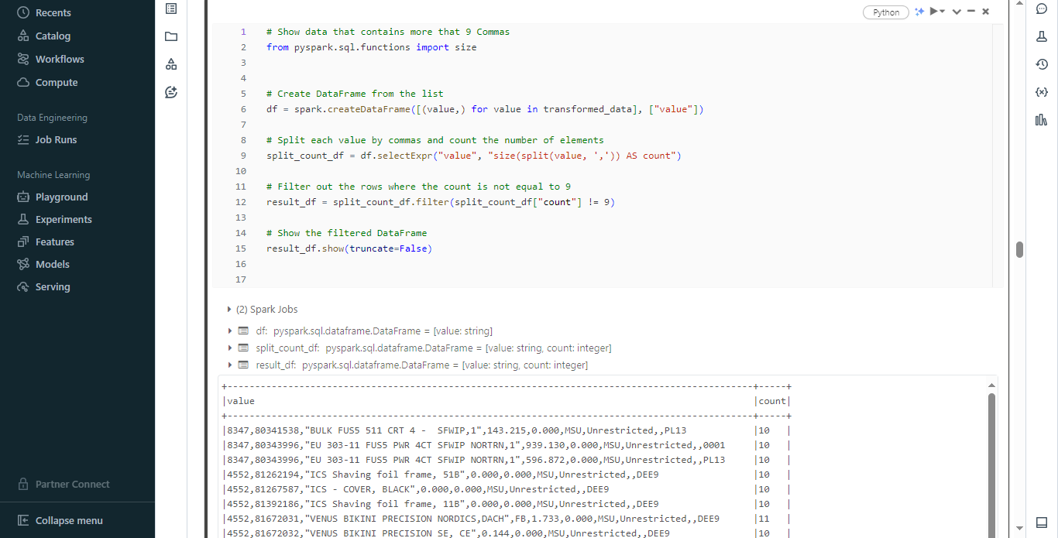
DATA MANIPULATION CsV WRONG FORMAT

Slide 13
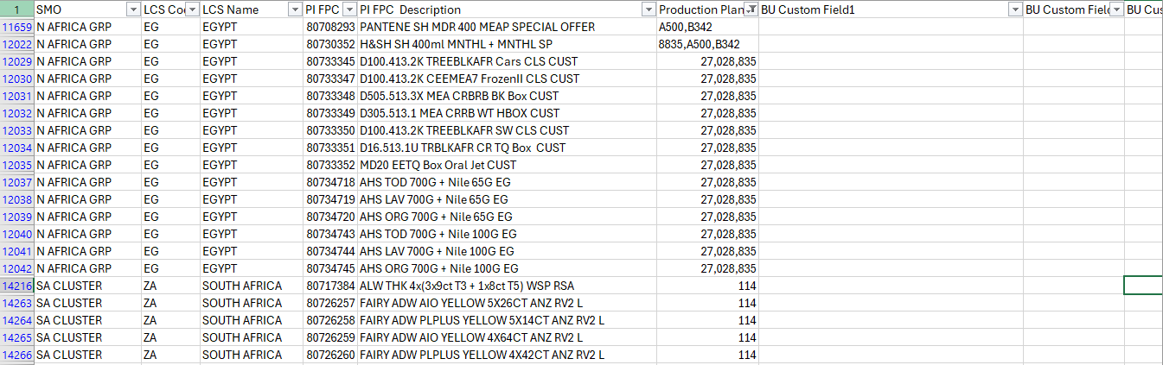
DATA MANIPULATION combined rows

Slide 14
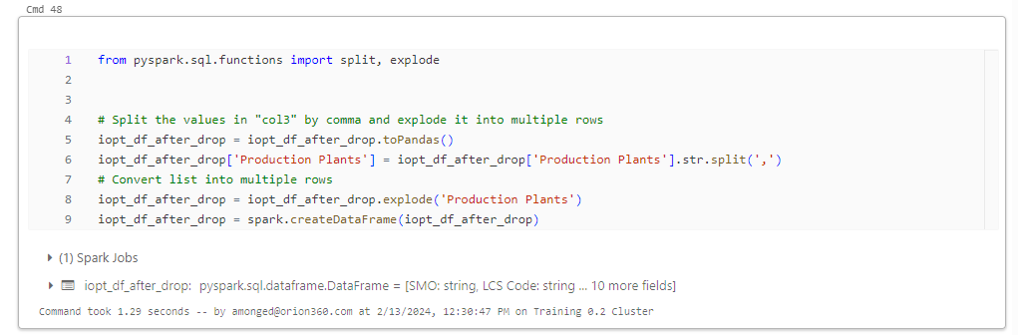
DATA MANIPULATION combined rows

Slide 15
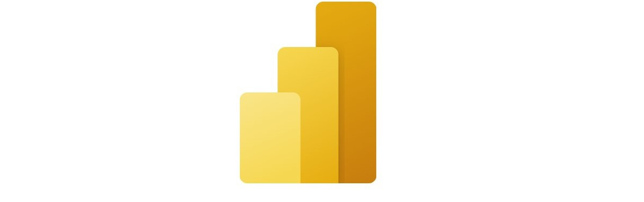
POWER BI

Slide 16
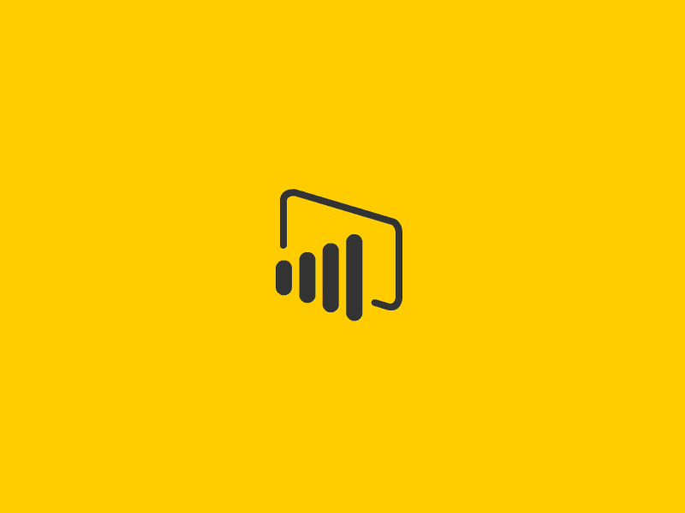
About POWER BI
Power BI is a powerful business analytics tool that allows users to visualize and analyze data from various sources.
Power BI empowers organizations to make data-driven decisions and gain valuable insights into their business operations.

Slide 17

DATA MODELING

Slide 18
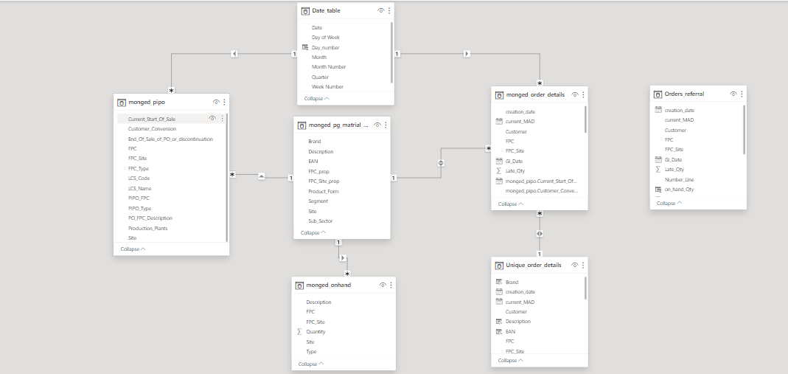
INTRODUCTION ABOUT POWER BI

Slide 19

dax

Slide 20
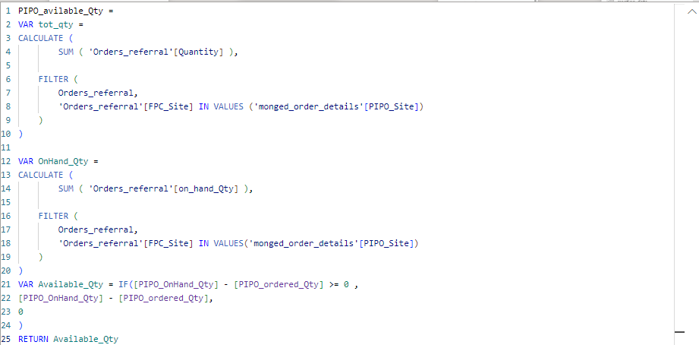
Dax measures & calculations

Slide 21

dashboard

Slide 22
